Slide 1

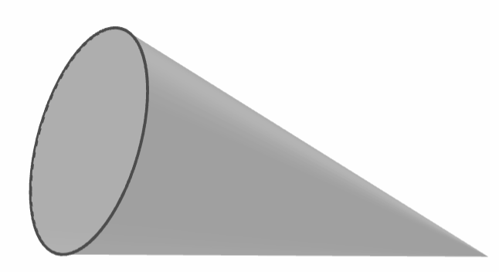
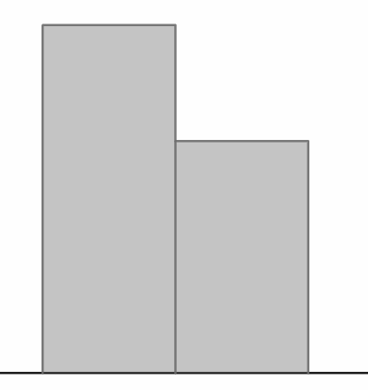
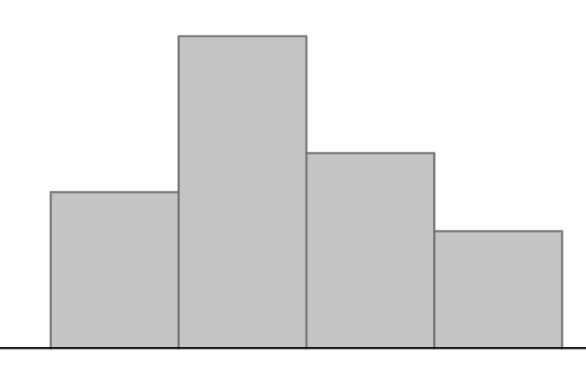
Experiments to determine how likely an outcome is
Task A: Planning and conducting experiments
1) A dropped cone could land in one of two ways: ‘base down’ or ‘curve down’.
a) Plan an experiment to investigate which outcome is most likely to happen.
A - base down
B - curve down
Example answers: ‘Drop a cone 50 times.’ OR ‘Drop a cone onto the floor from the same height 200 times. Record the number of times it lands in each position.’ Number of trials may vary. A larger number of trials is encouraged but you may also consider practical limitations for an experiment.
b) The bar chart shows the results from an experiment. The cone is about to be dropped again. In which position is it most likely to land?
6
4
frequency
A - base down
2
0
A
B
c) Use the link to access a simulation of this experiment: Cone simulation🖇 Press the ‘run’ button to begin the simulation and the ‘reset’ button to start again. Try this multiple times with a large number of trials each time. How do the results affect your answers to part (b)?
E.g. ‘When using a large number of trials, the cone lands curve down more often than base down. So curve down appears to be the more likely outcome.’
Answers may vary depending on results from the simulation.
2) A toy brick that is thrown into the air could land in one of four possible ways. In an experiment, the toy brick is thrown 20 times and produces the following results.
A - up
B - down
8
6
frequency
4
C - long face
D - short face
2
0
A
B
C
D
a) The toy brick is about to be thrown again. Draw a scale of likelihoods and use the results from the experiment to show the likelihood of each outcome on the scale.
D
A
C
B
impossible
unlikely
even chance
likely
certain
b) Use the link to access a simulation of this experiment: Toy brick simulation🖇 Press the ‘run’ button to begin the simulation and the ‘reset’ button to start again. Try this multiple times with a large number of trials each time. How do the results affect your answers to part (a)?
E.g. ‘When using a large number of trials (e.g. 1000) outcome C happens the most often, so appears to have the greatest likelihood. Outcome A happens the least often, so appears to have the least likelihood.’
Answers may vary depending on results from the simulation.

Slide 2
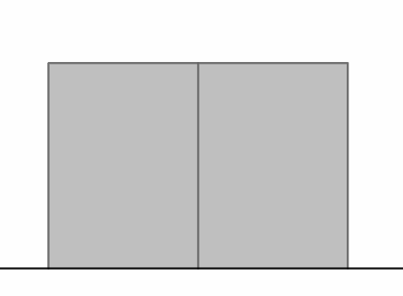
Experiments to determine how likely an outcome is
Task B: Considering the number of trials required
1) A class investigates which outcome is most likely when a frisbee is flipped.
a) An experiment is conducted with 10 trials. The bar chart shows the results.
Does one outcome appear more likely to happen than the other? If so, which one?
6
4
frequency
2
The outcomes appear equally likely.
0
heads
tails
b) Use the link to access a simulation of this experiment: Frisbee flip simulation🖇 The box that says ‘count’ shows the number of trials completed. Press the ‘run’ button to begin the simulation and let it run for at least 500 trials.
How do the results from this experiment differ to those in part (a)?
E.g. ‘When using a large number of trials, heads happens slightly more often than tails. This could suggest that heads is slightly more likely than tails.’
c) Which experiment’s results seem more reliable? Justify your answer.
The results from the experiment in part (b) are more reliable because it uses a much greater number of trials.
Mathematics in Education and Industry
v2.3

